Slide 1
Design And Analysis of Algorithms
Department of Information Technology
-----Group Members-----
ABHINAV ( IIT2019098 )
HARSH SHARMA ( IIT2019097 )
RIYA GOYAL ( IIT2019096 )
Under the Supervision of: Dr. Mohammad Javed
Under the Mentorship of: Mr. Md Meraz

Slide 2
OUTLINES
Introduction and Problem Statement
Divide and Conquer
Data Structures Used
Experimental Analysis
Conclusion
References

Slide 3
Problem Statement
“Given an integer n, find the number of positive integers
whose factorial ends with n zeros. ”

Slide 4
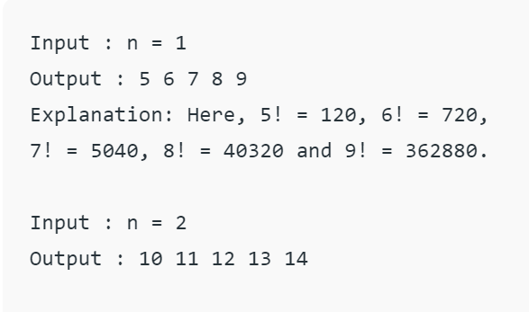
An Example

Slide 5
Divide and Conquer
Divide and Conquer is a Programming Paradigm which recursively breaks down the problem into sub problem and finds the required answer by making decisions on the answers found for those sub-problems.
This technique has a wide variety of uses. Binary Search and Merge Sort are some such example.

Slide 6
Algorithm
Input required number of zeroes to find for
Algorithm based on Divide and Conquer(Binary search)
Output the numbers which have given number of zeroes

Slide 7
Algorithmic Steps
1. Input the number n.
2. Create a function distance which will calculate the number of trailing zeroes in factorial of n.
3. Create a variable, lets call it a.
4. Implement Binary search, initially lo=1,hi=5*n.
5. Count the number of trailing zeroes in mid, if it is less than n update lo=mid+1, else update hi=mid-1 and store mid in 'a'(a=mid).

Slide 8
Algorithmic Steps
6. Finally check if number of trailing zeroes in factorial of a has exactly n zeroes or not, if it has print 'a' along with next 4 numbers(because a range of 5 numbers will always have equal trailing zeroes, as we are not multiplying extra '5' in that range (for trailing zeroes we need factor of 10=2*5, but in factorial the power of 2 will always be more than 5, so we just have to count for 5), otherwise if trailing zeroes in factorial of 'a' is more than n, we print that there doesn't exist any integer whose factorial
has exactly n trailing zeros.

Slide 9
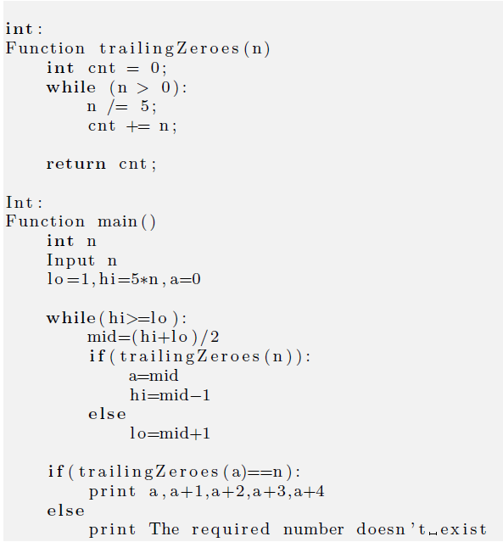

Slide 10
Time Analysis
T(n) = T(n/2) + log(n) if(n!=0) else T(n)=0
Using above relation, we get for T/2, T/8 etc. as:
T(n/2) = T(n/4) + log(n)
T(n/4) = T(n/8) + log(n)
T(n/8) = T(n/16) + log(n) and so on. . . . . .
.
.
.
.
Thus on combining we get the overall time complexity
as:T(n) = T(log(n)log(n))

Slide 11
Time Analysis O(log(n)log(n))
Figure 3: Time Analysis

Slide 12
Space Analysis O(1)
Figure 4: Space Analysis - By the experimental analysis, we found that in any case, space taken is constant.

Slide 13
Applications
There are so many applications of Divide and Conquer:
Binary Search
Segment Trees
Merge Sort
Quick Sort
Strassen's Algorithm

Slide 14
Conclusion
1. So, with the above mentioned algorithms and their profiling, we come to the conclusion that this problem of finding the number of integers with trailing zeroes equal to n is achieving its best time complexity of O(log(n)log(n)) and space complexity of O(1).
2. Also, binary search (or a part of divide and conquer) proved to be the most efficient algorithm here.

Slide 15
References
1. Introduction to Divide and Conquer Technique:
https://www.geeksforgeeks.org/divide-and-
conquer-algorithm-introduction/
2. Introduction to Algorithms by Cormen, Charles, Rivest and Stein.
https://web.ist.utl.pt/fabio.ferreira/material/asa

Slide 16
THANK YOU !!

